Slide 1
Research Data Management
November 2014
Valerie McCutcheon, Research Information Manager
Notes:
GU work and demo of registry

Slide 2





Why?
Do data management requirements apply to my work?
Yes
Policy intent towards open access of research outputs. Listened to researcher views on complexities.
& Any other Research - Good Research Practice, Freedom of Information, Data Protection
Future Research Excellence Framework Exercises

Slide 3
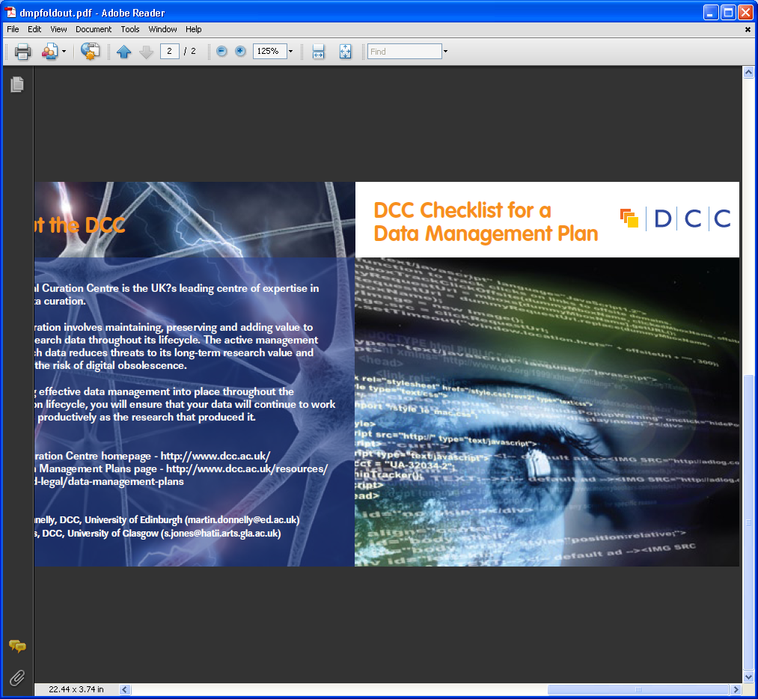
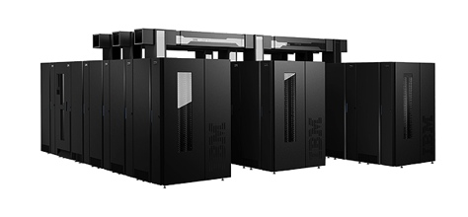

Open Access Policies –
Data Access
Papers should also include a statement on how the underlying research materials - such as data, samples or models – can be accessed. It is not necessary that the data itself be openly accessible if there are compelling reasons against this.
Fully automated and managed solution
https://dmponline.dcc.ac.uk/

Slide 4
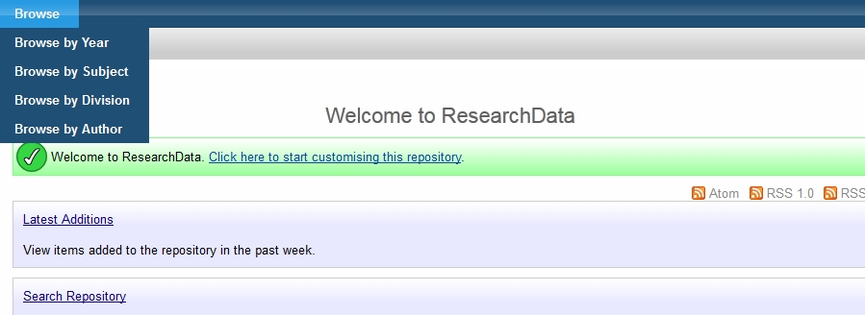

Research Data – Support Available
Data registry January 2013
Provide data storage for those who need it
Training and support - e.g. Data Management Plans
Seek clarification of requirements
Notes:
3

Slide 5
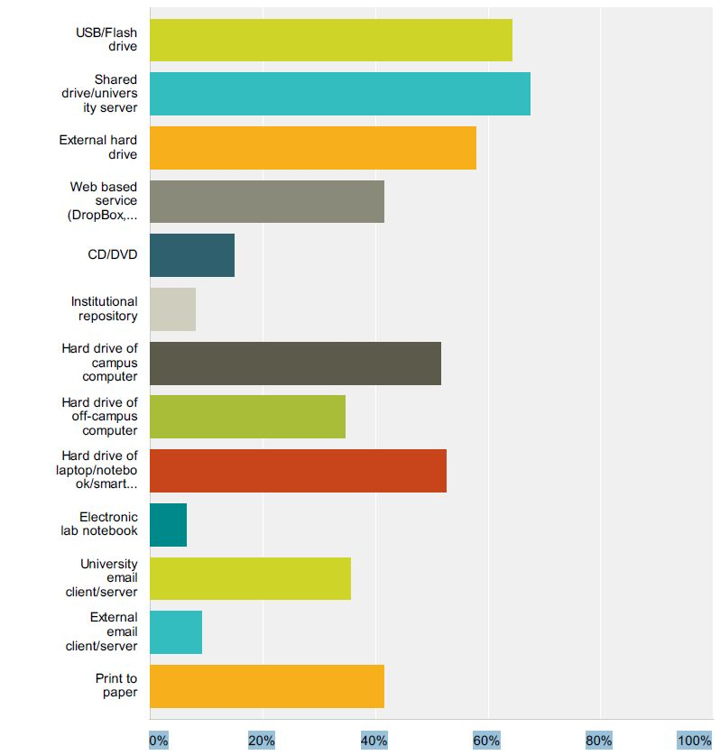
Data Registry
LIVE JANUARY 2013
        Help with data citation
        Linked data storage
        Visibility for datasets
Notes:
DataCite. Robust data storage. Simple and clean metadata schema. Digital Object Identifier (DOI) per collection (not file). New version needs new DOI. Includes advice on citation.
4

Slide 6
Metadata
Title of dataset
Creator/s
Original Publication URL
Publication Date of dataset
Notes:
5

Slide 7
Digital Object Identifier Service
Some journals require
Allows the impact of data to be tracked
Glasgow format
‘10.XXXX/gla.researchdata.2013.29’
Example from UKDA:
http://dx.doi.org/10.5255/UKDA-SN-7106-1
Notes:
6

Slide 8


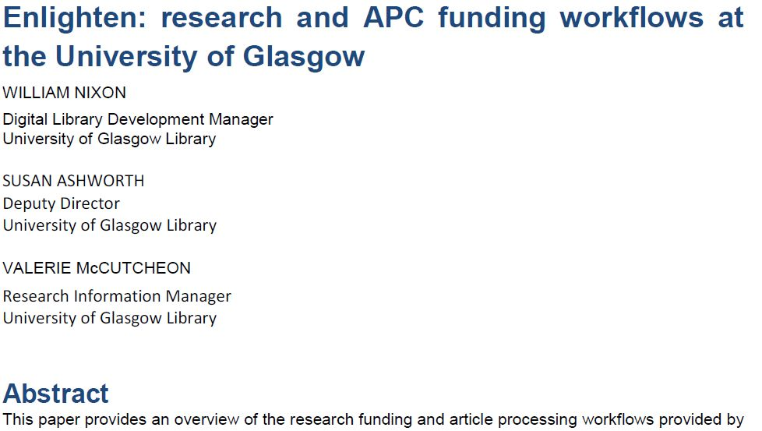
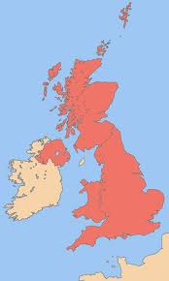

The Future?
Your Research Paper
http://researchdata.gla.ac.uk/
Notes:
7

Slide 9
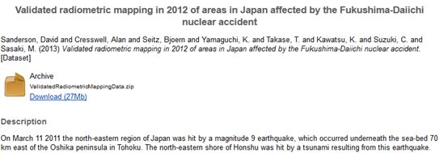
Dataset Record

Slide 10
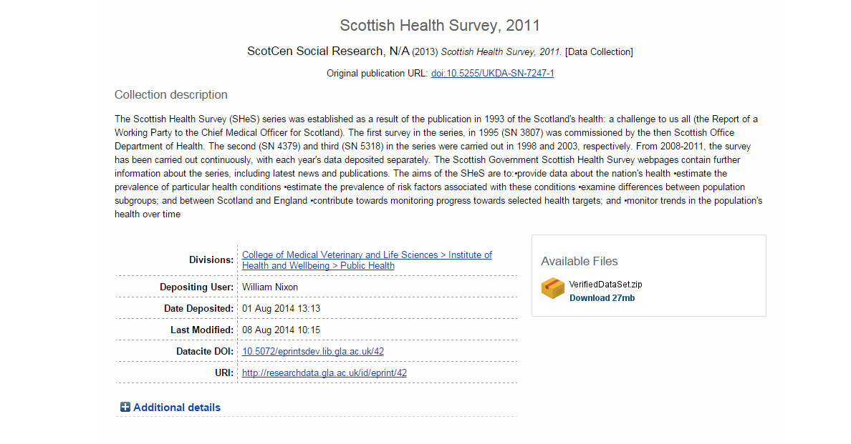
Dataset Record

Slide 11
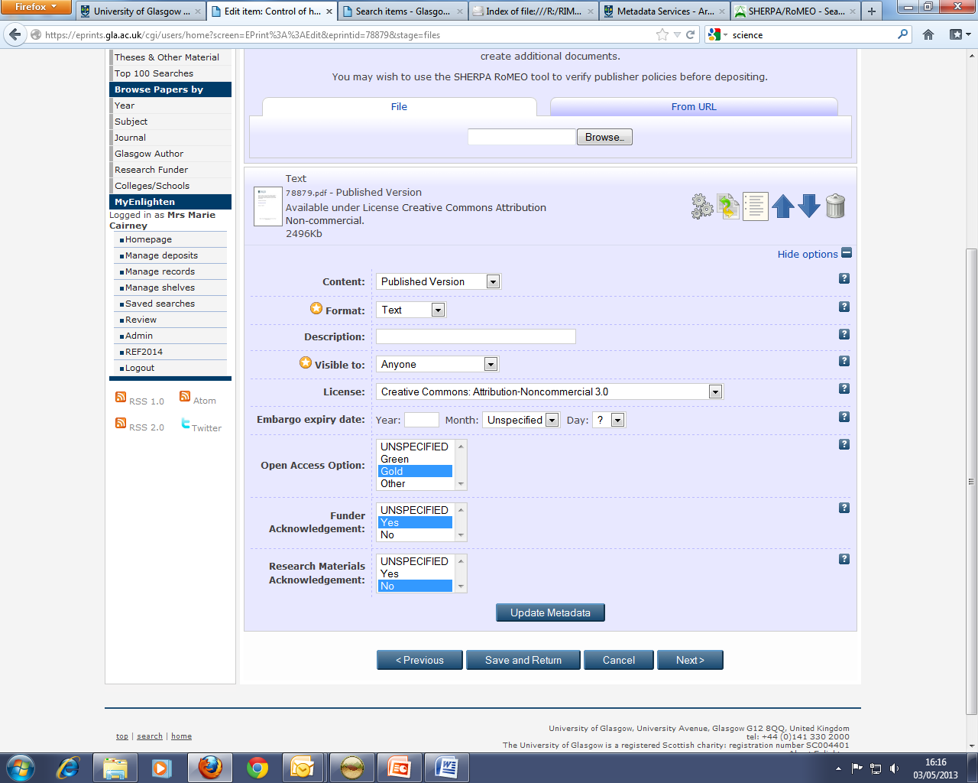
Notes:
This is a back office screen used by the publications repository (Enlighten) team and does not show publicly. Encouraging inclusion of dataset information in papers and checking compliance. It allows us to report to RCUK.

Slide 12
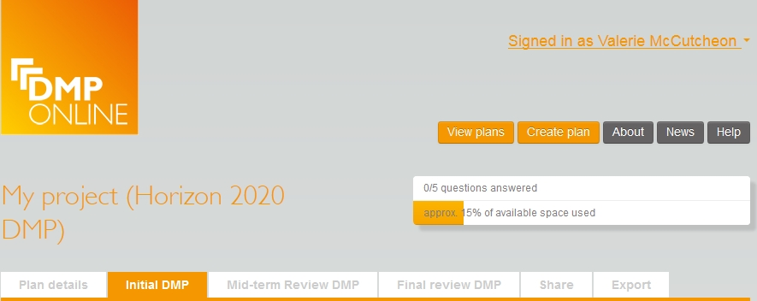
Data Management Plans
https://dmponline.dcc.ac.uk

Slide 13
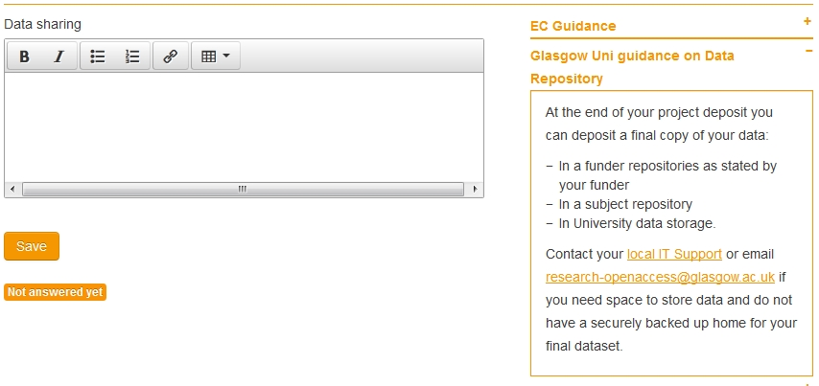
Data Management Plans
University of Glasgow Guidance Built In
https://dmponline.dcc.ac.uk

Slide 14
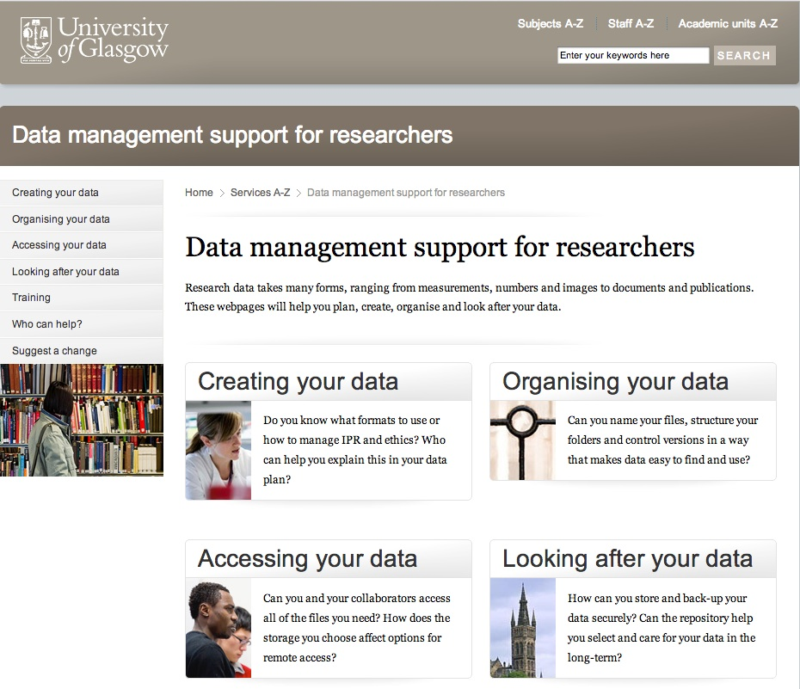
http://www.gla.ac.uk/services/datamanagement/

Slide 15
What MUST staff do?
Key Actions
        Ensure robust data storage - funders, subject repository, or secure backed up location
        Adhere to University Code of Good Practice in Research http://www.gla.ac.uk/media/media_227599_en.pdf
        Add a statement on how to access underlying research materials to acknowledgements on papers
        How can we help you?
        research-openaccess@glasgow.ac.uk

